Slide 1
Kickstarter Insights
Melissa Lin

Slide 2
3 conclusions based on the data set
Subcategory
Plays have the highest count of kickstarters
Most popular subcats with 100% successful kickstarters: Classical Music, Electronic Music, Hardware, Nonfiction, Pop, Tabletop games
Category
Theater has the highest count of successful kickstarters, but Music has the highest % of successful kickstarters
Date
May, June and July are the most popular months to run a Kickstarter

Slide 3
Limitations of data set
74% of the observations are from the US, skewing the overall results by category and subcategory.

Slide 4
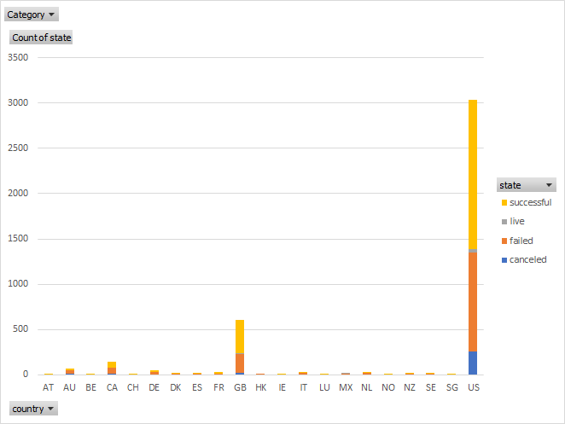
Other possible tables/graphs to create
Number of Kickstarter by country

Slide 5
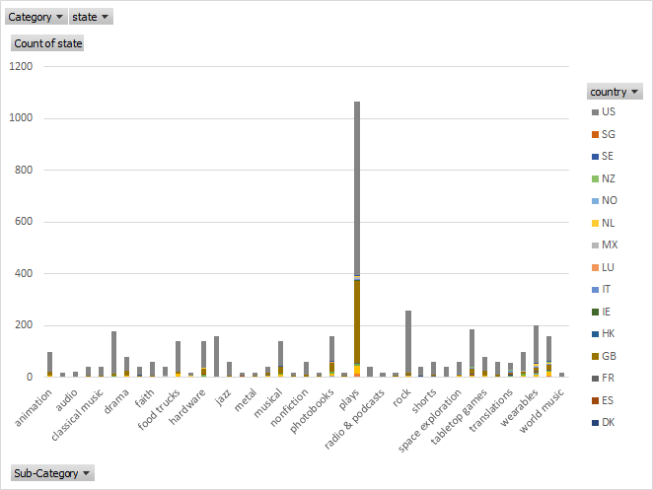
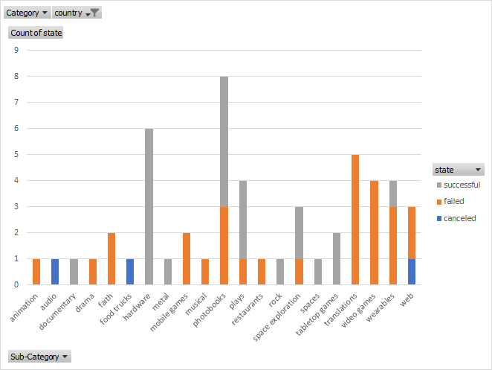
Other possible tables/graphs to create
Subcategory: Stacked chart by country
All Countries
Germany

